Slide 1
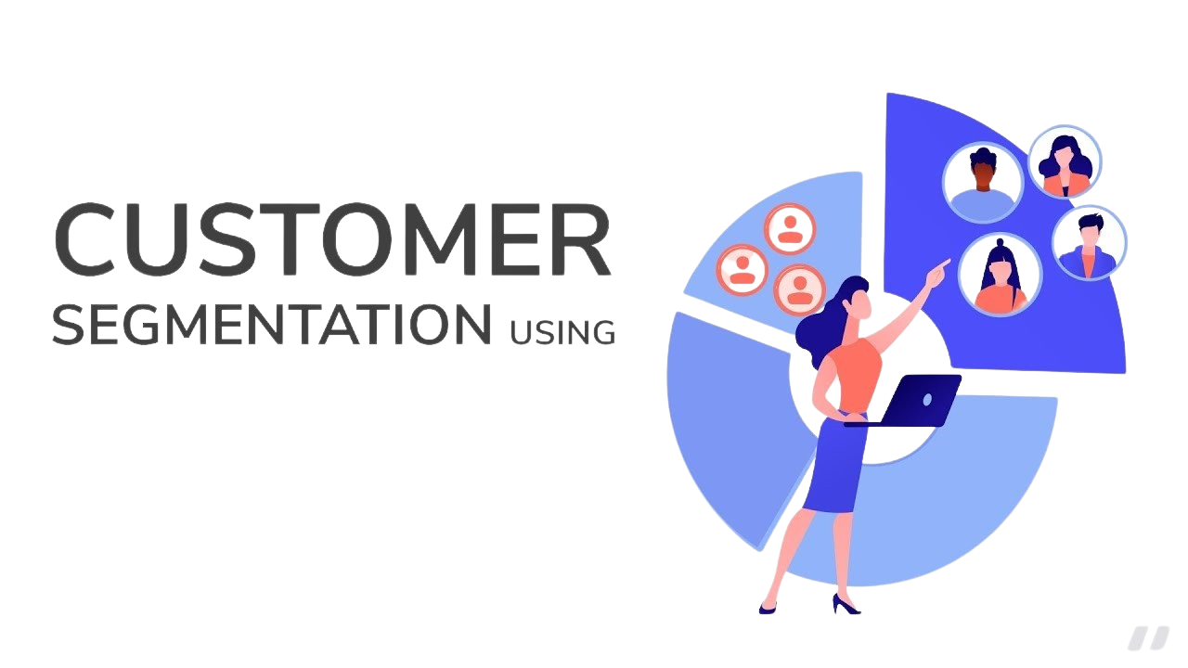
Machine Learning
AJIL ALEYAS: 87953365
ROBIN KURIAN : 29853812
GOURAV SINGH : 83659551

Slide 2
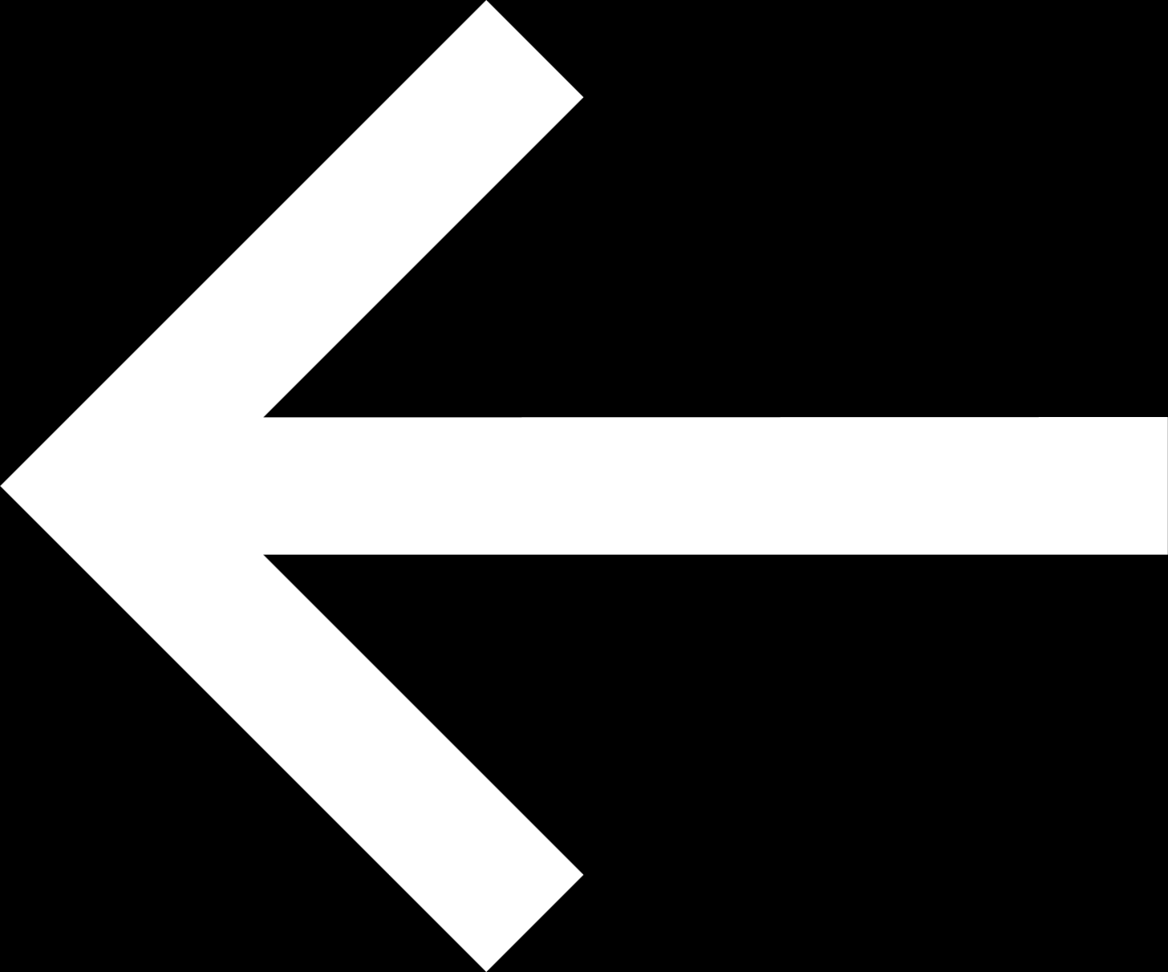
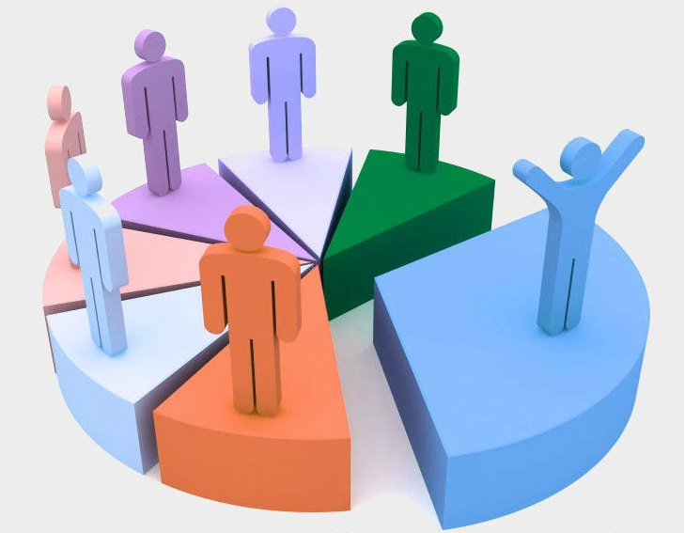



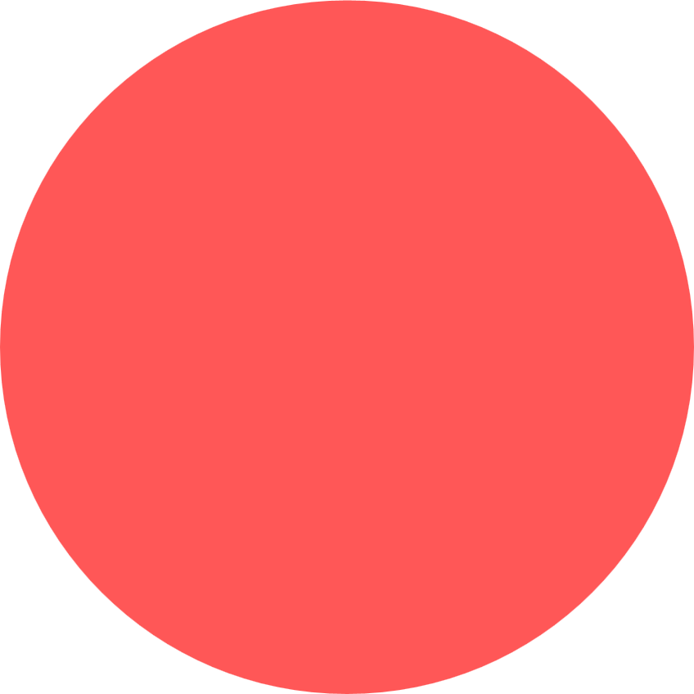
PROBLEM STATEMENT
The most successful companies today are the one's who know their customers so well that they are able to anticipate their needs beforehand. This can better be achieved if we can segment the customers into different groups that reflect the similarities among the customers in each group. The goal of the segmentation is to foresee the needs of customers, get to know their interests, lifestyles, priorities and learn their spending habits so that to maximize the value of customers to the business
CLIK HERE

Slide 3
Data Set
Customer ID: Id of customer, this field will be dropped as it's not useful
Gender: customer gender - female / male
Age: age of customer, we've got customers with age from 18 to 70 years
Annual Income: income of customer, will be renamed to income only, values from 13 to 137
Spending Score: Score assigned by the mall based on customer behavior and spending nature, values from 1 to 99

Slide 4
Preprocessing the Dataset
1. Data Collection
2. Importing libraries
3.Importing Dataset
4. Checking Null values/Missing Data in the Dataset
5. Feature selection(“Age”, “Annual Income” and “Spending Score”
Here we remove the unwanted column “Customer ID” that has no much impact in the
6. Feature Scaling
Standardize the features to ensure they have a mean of zero and a standard deviation of one. This step is essential because K-means clustering relies on distance metrics, which can be distorted by differing feature scales.
Since gender is a categorial variable, it needs to be encoded and converted to numeric. Before using the data for training the model we need to make sure mean = 0 and standard deviation =1

Slide 5
Unsupervised Machine Learning Model
Customer segmentation is an unsupervised machine learning model because it involves grouping customers into segments based on similarities in their data without using predefined labels or categories. Hence it comes under Classification model.
Why K Means Algorithm?
K-Means algorithm is widely used for customer segmentation due to several key reasons that align well with the objectives and requirements of segmenting customers
1. Simplicity and Efficiency
2. Scalability
3. Clear and Actionable Output
4. Flexibility
5.Effective Initialization and Convergence
6. Visualization and Interpretation
7. Optimization and Validation

Slide 6
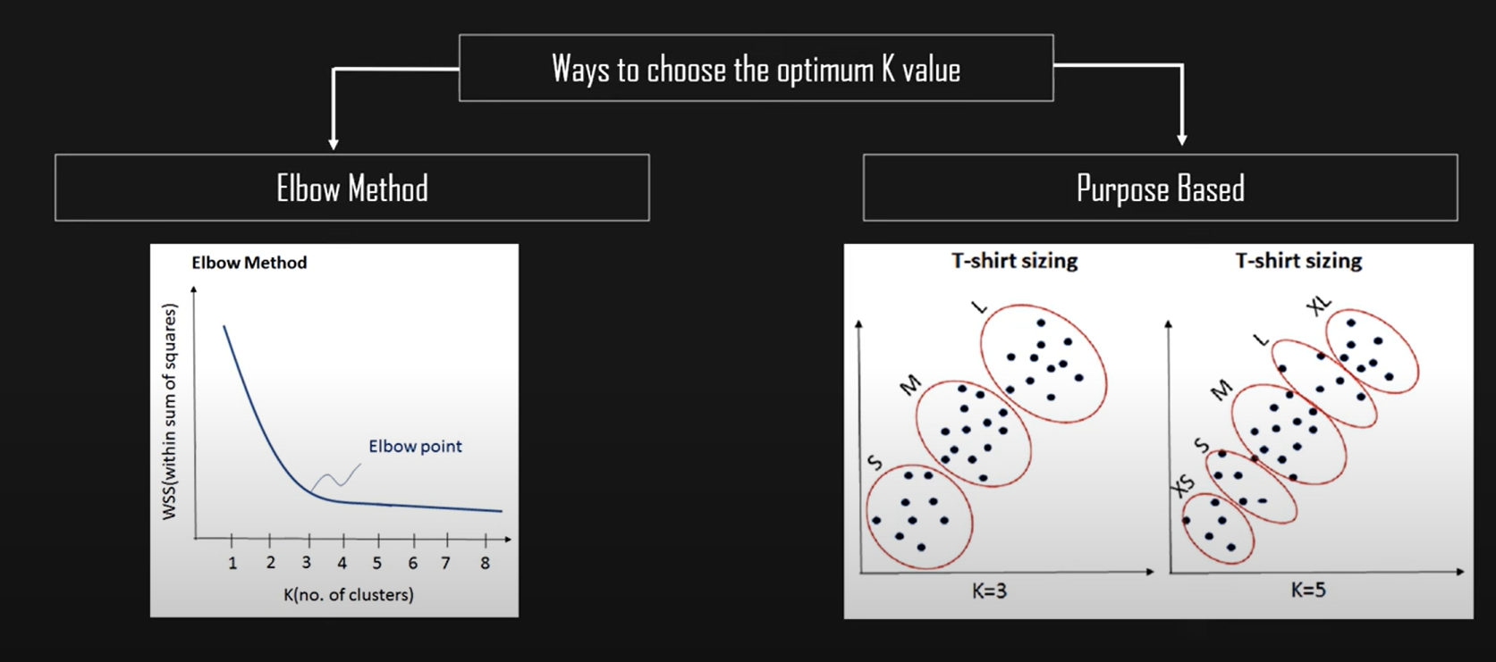
Evaluation Criteria
Here we are using Elbow method. This method helps determine the optimal number of clusters (k). It involves plotting the sum of squared distances (inertia) between data points and their corresponding cluster centroids for different values of k. The "elbow point" on the plot, where the inertia starts to decrease more slowly, indicates a suitable number of clusters

Slide 7
Comparison Algorithm- Agglomerative Algorithm & DBSCAN
Agglomerative clustering works in a “bottom-up” manner. That is, each object is initially considered as a single-element cluster (leaf). At each step of the algorithm, the two clusters that are the most similar are combined into a new bigger cluster (nodes).
DBSCAN (Density-Based Spatial Clustering of Applications with Noise) is a popular clustering algorithm that is particularly well-suited for datasets with noise and clusters of varying shapes and sizes. Unlike other clustering algorithms, such as k-means, DBSCAN does not require the user to specify the number of clusters in advance. Instead, it relies on two key parameters: epsilon (ε) and minimum points (minPts).

Slide 8
Result
Conservative Spenders: This cluster includes customers with a higher average age and annual income, but a lower spending score. They may be more conservative with their spending and focused on saving their money.
Young and Wealthy: This cluster includes customers with a lower average age and a high annual income and spending score. They are likely younger, wealthier customers who are more likely to spend on luxury goods and experiences.
Budget Shoppers: This cluster includes customers with a lower average age and annual income, but a relatively high spending score. They may be focused on getting the most for their money and finding deals and discounts.
Middle-Aged Moderates: This cluster includes customers with a higher average age and a moderate annual income and spending score. They may be more conservative with their spending than the Young and Wealthy cluster but still have more disposable income than the Budget Shoppers cluster.

Slide 9

THANK YOU!!

